Slide 1
University of Diyala
College of Engineering
Department of Architecture
1ST Stage
2018 – 2019
Lecture_ 02

Slide 2
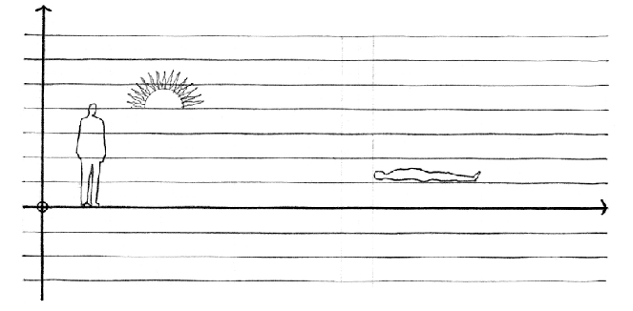
Line:
A point extended becomes a line. Conceptually, a line has length, but no width or depth. Whereas a point is by nature static, a line, in describing the path of a point in motion, is capable of visually expressing direction, movement, and growth.

Slide 3
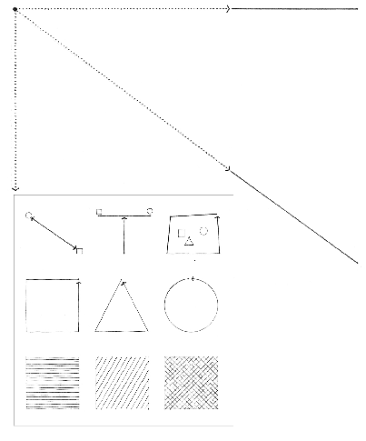
A line is a critical element in the formation of any visual construction. It can serve to:
join, link, support, surround, or intersect other visual elements.
describe the edges of and give shape to planes.
articulate the surfaces of planes.

Slide 4
Although a line theoretically has only one dimension, it must have some degree of thickness to become visible. It is seen as a line simply because its length dominates its width. The character of a line, whether taut or limp, bold or tentative, graceful or ragged, is determined by our perception of its length–width ratio, its contour, and its degree of continuity.

Slide 5
The orientation of a line affects its role in a visual construction. While a vertical line can express a state of equilibrium with the force of gravity, symbolize the human condition, or mark a position. In space, a horizontal line can represent stability, the ground plane, the horizon, or a body at rest.
An oblique line is a deviation from the vertical or horizontal. It may be seen as a vertical line falling or a horizontal line rising. In either case, whether it is falling toward a point on the ground plane or rising to a place in the sky, it is dynamic and visually active in its unbalanced state.

Slide 6
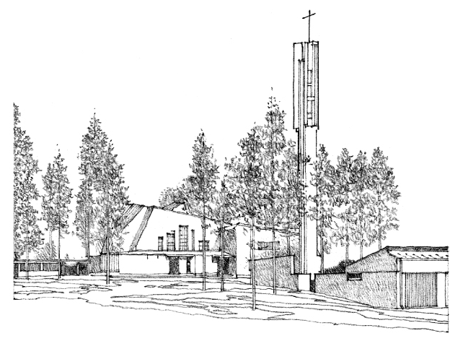
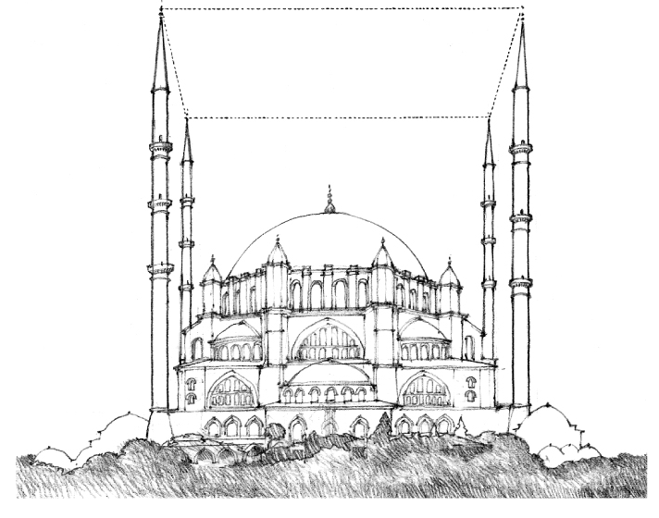

Slide 7
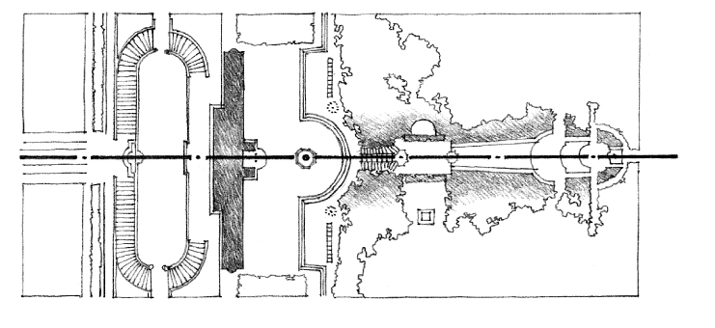

Slide 8
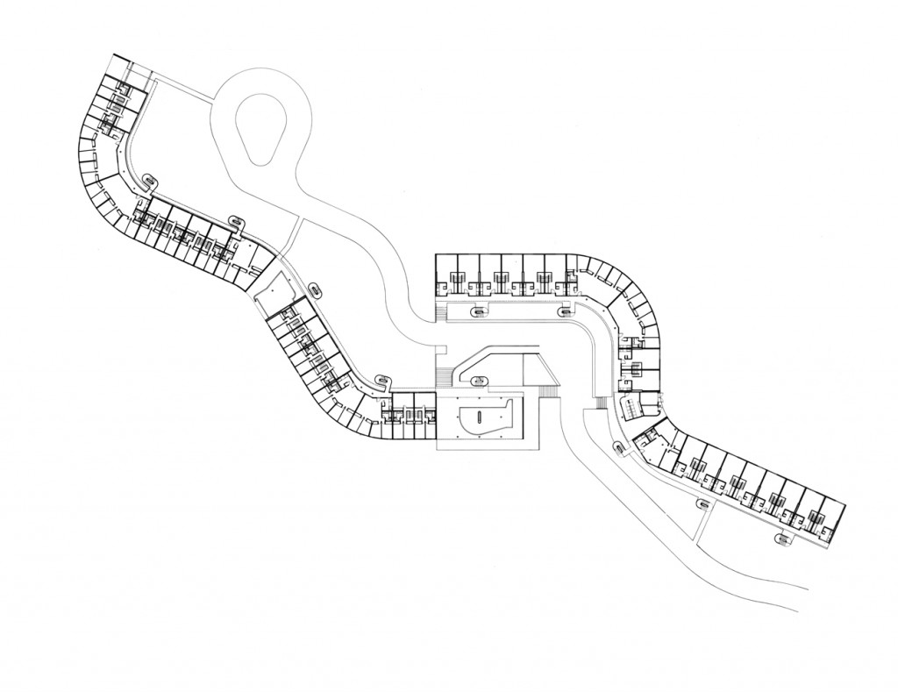
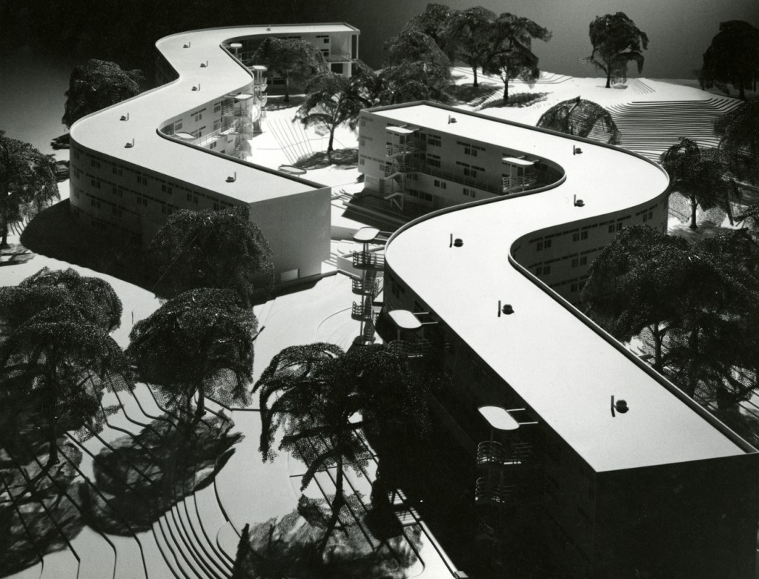
LINEAR ELEMENTS

Slide 9
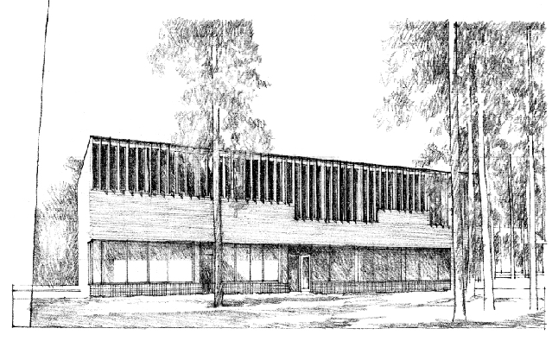
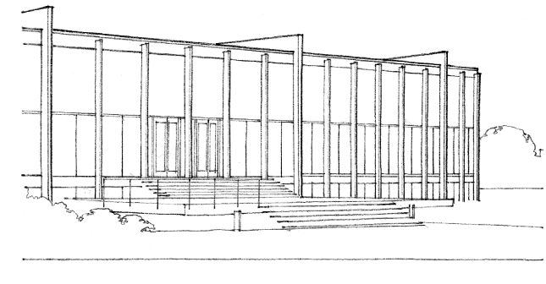

Slide 10
